Slide 1
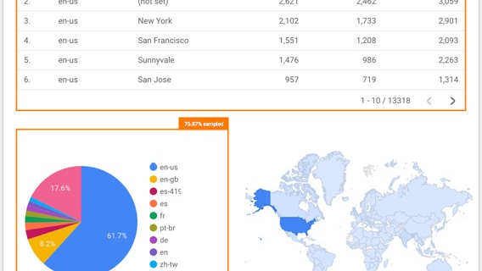
SEARCH INTELLIGENCE REPORT
Google Search
Analysis
India Trends Report: October 23-30, 2024
1,439 Trending Topics
36M+ Total Search Volume

Slide 2
NAVIGATION
Executive Overview
01
Search Landscape Overview
02
Sports Dominance
Comprehensive analysis of India's digital search ecosystem, scale metrics, and volume distribution patterns across 1,439 trending queries.
Deep dive into cricket's commanding presence with 13.5M+ searches, international matches, and sporting event trends.
03
Finance & Investment
04
Festival Season Impact
Market movements, IPO frenzies, precious metals interest, and the 4.3M+ search volume driving financial curiosity.
Diwali and Dhanteras driving 2.6M+ searches, cultural celebrations, and seasonal search behavior patterns.
05
Entertainment & Technology
06
Key Insights & Implications
Movies, OTT platforms, tech adoption, and the digital transformation reflected in search behavior.
Strategic takeaways, consumer behavior patterns, and actionable intelligence for businesses and marketers.

Slide 3
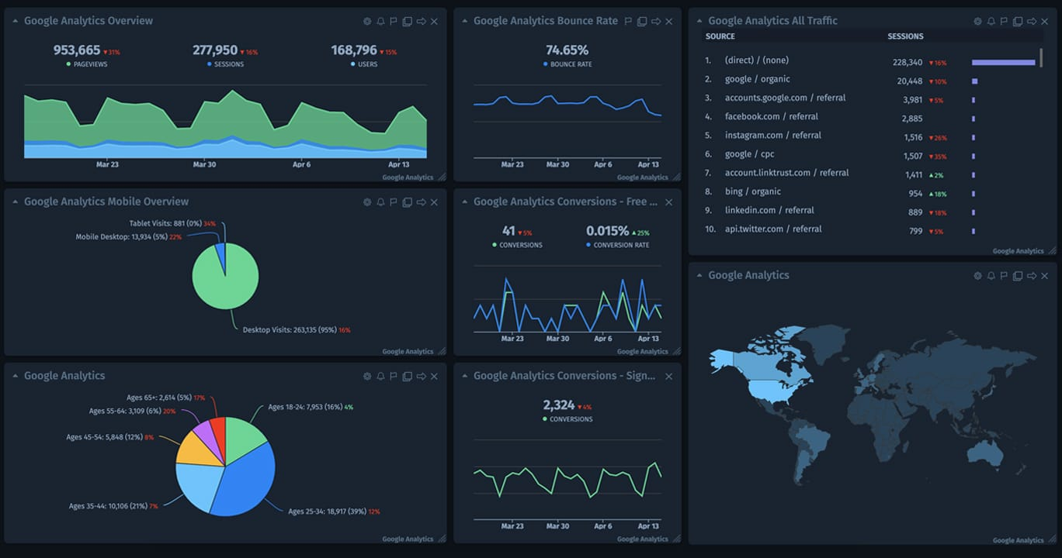
01
Search Landscape
Overview
Understanding India's Digital Search Behavior

Slide 4
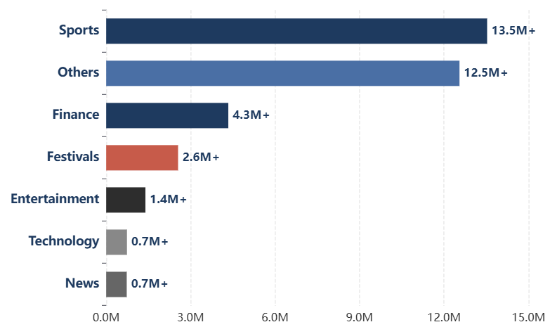
SEARCH LANDSCAPE OVERVIEW
The Scale of Indian Search Activity
Total Search Volume by Category
Key Metrics
Total Topics Analyzed
1,439
Analysis Period
Oct 23-30, 2024
Peak Single Query
5M+
Total Volume
36M+
Category Distribution
Sports
229 topics
Finance
142 topics
News
54 topics
Technology
53 topics

Slide 5
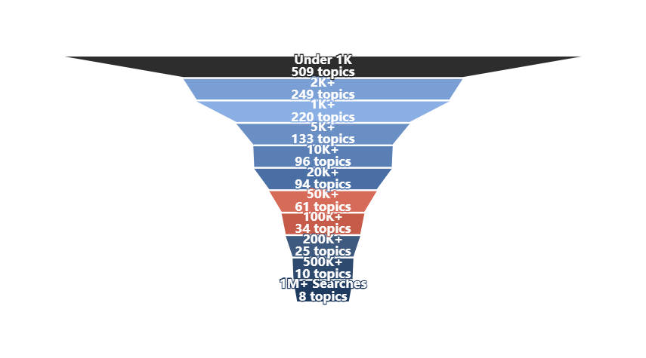
SEARCH LANDSCAPE OVERVIEW
Search Volume Distribution Patterns
Search Volume Pyramid: Query Distribution Across Tiers
Volume Tier Analysis
Ultra-High (1M+)
8
Massive events: Cricket matches, major IPOs, festivals
Very High (500K+)
10
Significant interest: Sports, gold prices, entertainment
High (100K+)
59
Strong engagement: Movies, exams, news events
Medium (10K+)
190
Steady interest: Diverse topics across categories
Long Tail (Under 10K)
1,172
Niche queries: Specific interests, local events

Slide 6
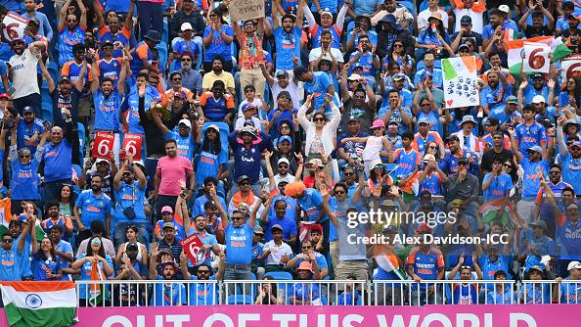
02
Sports
Dominance
Cricket, Football & Beyond: India's Sporting Obsession

Slide 7
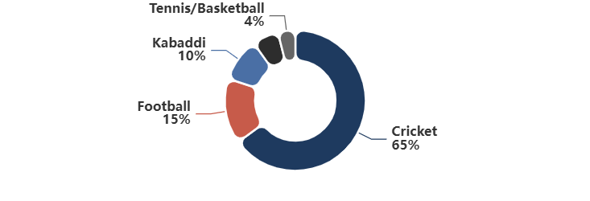
SPORTS DOMINANCE
Sports: The Undisputed Search Leader
Sports Category Leadership
Top Sports Queries
229
13.5M+
37.5%
New Zealand vs India
5M+
Topics
Total Volume
Share
Test match series - peak interest
Sports dominates India's search landscape with cricket commanding the highest volumes. International matches, IPL discussions, and women's cricket growth drive massive engagement.
NZ Women vs India Women
2M+
Women's cricket rising popularity
South Africa vs Bangladesh
1M+
International cricket interest
Sports Category Breakdown
England vs Pakistan
1M+
Test series engagement
Real Madrid vs Barcelona
500K+
El Clasico - football passion
Insight: Cricket generates 80%+ of sports search volume, with international matches driving peak interest. Football, kabaddi, and other sports show strong secondary engagement.

Slide 8
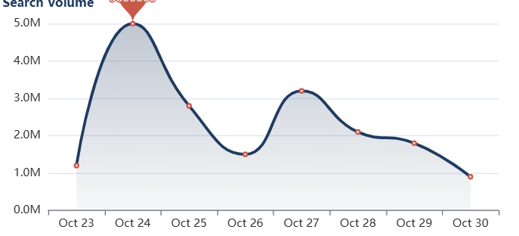
SPORTS DOMINANCE
Cricket Frenzy: Match-Specific Analysis
India vs New Zealand Test Series Impact
Cricket Search Categories
Match Schedules & Scores
Live scores, match timings, and schedule queries dominate cricket searches during active series. Real-time updates drive sustained engagement.
Team & Player Information
Player statistics, team lineups, and performance analysis generate significant search volume, especially during international tournaments.
Tournament Context
Player Search Interest
World Test Championship points table, rankings, and qualification scenarios drive searches beyond individual matches.
Mitchell Santner
1M+
Washington Sundar
500K+
Women's Cricket Growth
2M+ searches for women's matches indicate rapidly growing interest and viewership in women's cricket.
Daryl Mitchell
20K+
Glenn Phillips
20K+

Slide 9
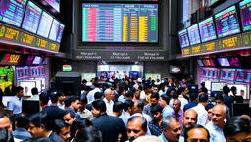
03
Finance &
Investment Trends
Market Movements & Investment Interest

Slide 10
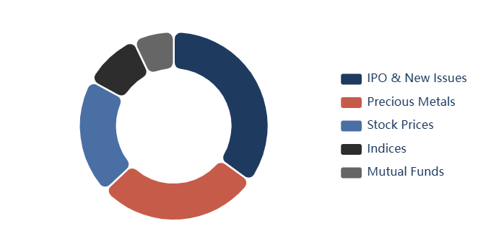
FINANCE & INVESTMENT TRENDS
Financial Markets Drive Significant Search Activity
Finance Category Overview
Finance Sub-Categories
142
4.3M+
12%
Topics
Total Volume
Share
Finance generates sustained search interest with IPOs, precious metals, and stock tracking leading the category. Festival season amplifies gold and silver searches.
Top Financial Queries
Waaree Energies IPO
2M+
Allotment Status
Gold Price Today
500K+
Key Financial Insights
Daily tracking
IPO Frenzy
Elcid Investment
200K+
Waaree Energies IPO generated 2M+ searches, indicating massive retail investor participation and market enthusiasm.
Share price
Silver Rate Today
Festival Gold Rush
Precious metals
200K+
Gold and silver searches spike during Dhanteras and Diwali, reflecting cultural investment patterns.
Muhurat Trading
100K+
Stock Tracking
2024 timing
Individual stock queries (Reliance, Yes Bank, IndusInd) show active retail trading interest.

Slide 11
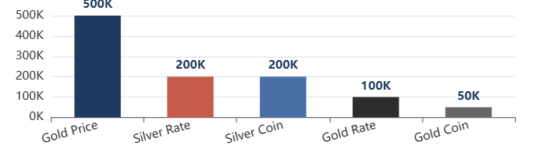
FINANCE & INVESTMENT TRENDS
Investment Patterns & Market Sentiment
IPO Search Landscape
Stock-Specific Search Interest
Waaree Energies
2M+
Reliance Share Price
100K+
Allotment status, share price, listing gains
Consistent tracking of India's largest company
KFintech
200K+
IndusInd Bank
50K+
IPO details, subscription status
Banking sector interest
Danish Power
20K+
IDFC First Bank
50K+
IPO information, GMP
Private banking focus
PS Raj Steels
20K+
Yes Bank
20K+
SME IPO interest
Turnaround story interest
Insight: IPO searches peak during subscription periods and listing days, with allotment status being the most searched query type.
20K+
IRFC Share Price
Railway finance PSU
Precious Metals During Festivals
Cultural Finance Integration
Muhurat Trading: 100K+ searches for Diwali trading timings show cultural integration with financial markets.
Silver Coins: 200K+ searches for silver coins during Dhanteras reflect traditional investment practices.
Lottery Results: 200K+ searches for Dear Lottery, Kolkata Fatafat show alternative investment interest.

Slide 12
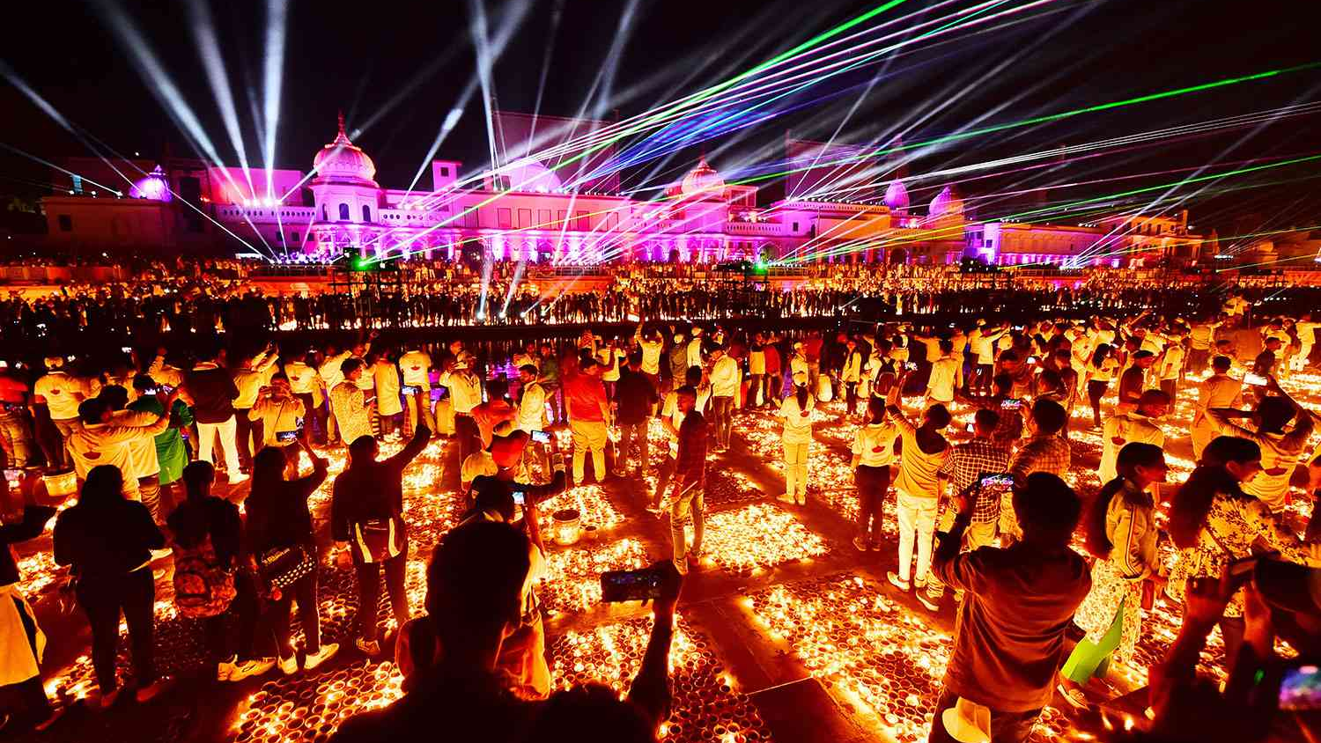
04
Festival Season
Impact
Diwali, Dhanteras & Cultural Celebrations

Slide 13
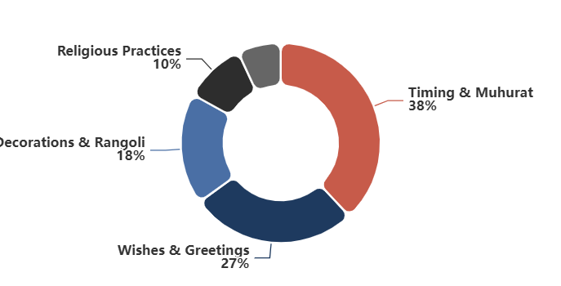
FESTIVAL SEASON IMPACT
Festivals Generate Massive Search Interest
Festival Category Impact
Festival Search Categories
21
2.6M+
7.2%
Topics
Total Volume
Share
Diwali week drives concentrated search activity with Dhanteras timing, wishes, and celebration-related queries dominating the category.
Top Festival Queries
Dhanteras Timing 2024
1M+
Shubh muhurat
Diwali
500K+
Cultural Significance in Searches
General searches
Timings & Muhurat
Diwali Wishes
200K+
Dhanteras timing (1M+) and Lakshmi Puja muhurat searches show cultural adherence to traditional practices.
Greetings sharing
Rangoli
Decorations & Art
Design ideas
200K+
Rangoli designs (200K+) and decoration ideas reflect the artistic aspect of celebrations.
Religious Practices
Happy Diwali Wishes
200K+
Aarti, katha, and vrat-related searches show continued interest in religious observances.
Image searches
Corporate Culture
Reliance Jio Diwali Gift (50K+) reflects interest in corporate celebrations and employee benefits.

Slide 14
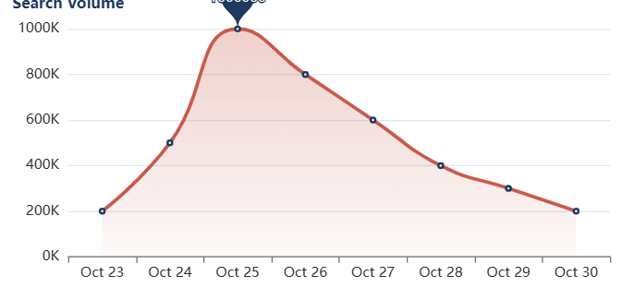
FESTIVAL SEASON IMPACT
Cultural Search Behavior During Festivals
Festival Search Timeline
Multifaceted Festival Searches
Timing & Muhurat Queries
Dhanteras Timing 2024 (1M+) leads festival searches, showing importance of auspicious timings in Indian culture.
Decoration Ideas
Rangoli (200K+) and decoration searches reflect the creative and aesthetic aspects of festival celebrations.
Greeting Sharing
Diwali Wishes (200K+) and Happy Diwali Wishes (200K+) show digital greeting culture adoption.
Related Festival Queries
Lakshmi Ji Ki Aarti
20K+
Holiday Information
Religious practice
Bank Holidays (50K+) and office closure queries reflect practical planning needs during festivals.
Govardhan Puja
20K+
Post-Diwali ritual
Chhath Puja
20K+
Bihar/UP festival
Bhai Dooj
50K+
Linguistic Diversity
Sibling celebration
Festival searches show strong regional language presence with Hindi queries (Dhanteras, Lakshmi Ji Ki Aarti) alongside English, reflecting India's multilingual digital behavior. Regional festivals like Chhath Puja (20K+) demonstrate geographic diversity in search patterns.
Ahoi Ashtami Ki Katha
50K+
Mother's fasting story

Slide 15
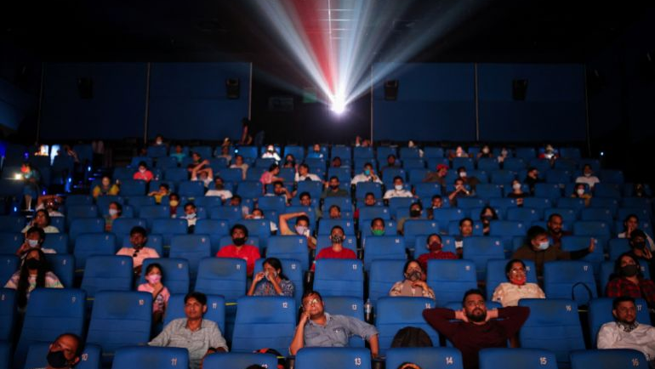
05
Entertainment &
Technology
Movies, OTT, Tech & Digital Behavior

Slide 16
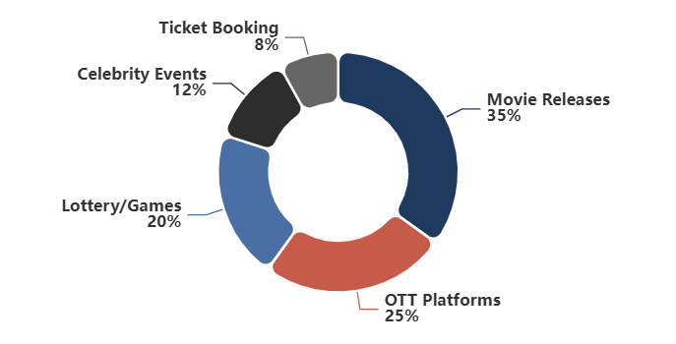
ENTERTAINMENT & TECHNOLOGY
Entertainment: Movies, OTT & Celebrity Culture
Entertainment Overview
Entertainment Categories
34
1.4M+
3.9%
Topics
Total Volume
Share
Entertainment searches peak around movie releases, OTT launches, and celebrity events. Bollywood and South Indian cinema drive significant engagement.
Top Entertainment Queries
Lottery Sambad
500K+
Results & numbers
JioHotstar
200K+
Movie Release Anticipation
Streaming platform
Bollywood Blockbusters
Vettaiyan OTT Release
100K+
Singham Again (100K+), Bhool Bhulaiyaa 3 (50K+), and Do Patti (50K+) show strong anticipation for big releases.
Rajinikanth movie
Singham Again
South Indian Cinema
Release date
100K+
Vettaiyan (100K+), Amaran (100K+), and Meiyazhagan (50K+) demonstrate pan-India appeal of South films.
Amaran Ticket Booking
100K+
OTT Platform Growth
Sivakarthikeyan film
JioHotstar (200K+) and OTT release date searches show streaming platform importance in entertainment consumption.
Live Events
Diljit Dosanjh concert (50K+) indicates interest in live entertainment and celebrity events.

Slide 17
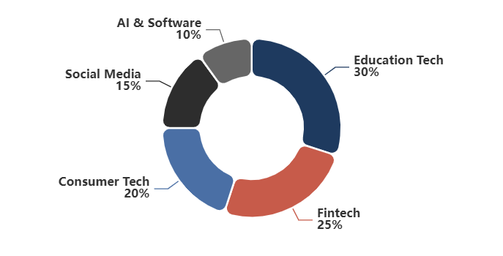
ENTERTAINMENT & TECHNOLOGY
Technology & Digital Services Interest
Technology Overview
Technology Categories
53
738K+
2.1%
Topics
Total Volume
Share
Technology searches span education, fintech, consumer tech, and social media. JEE Mains and fintech platforms show strong engagement.
Top Technology Queries
JEE Mains 2025
200K+
Education & exams
KFintech
200K+
Tech Search Insights
Financial technology
Education Technology
Apple Intelligence
20K+
JEE Mains 2025 (200K+) shows education-tech intersection with exam-related searches dominating.
AI technology
Instagram DMs
Fintech Growth
Social media
20K+
KFintech (200K+) and financial technology platforms show increasing digital finance adoption.
Mac Mini
10K+
AI Interest
Consumer tech
Apple Intelligence (20K+) indicates growing curiosity about AI features in consumer devices.
Social Media
Instagram DMs (20K+) and social platform searches reflect digital communication trends.

Slide 18
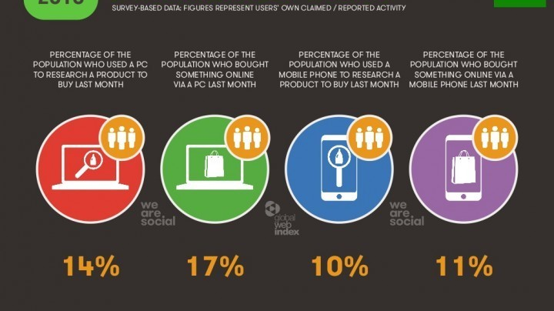
06
Key Insights &
Implications
Strategic Takeaways from Search Data

Slide 19
KEY INSIGHTS & IMPLICATIONS
Seven Critical Insights from India's Search Behavior
01
Sports Dominance is Unprecedented
02
Festival Season Drives Cultural Commerce
Cricket commands 13.5M+ searches (37.5% of total volume), with international matches driving 5M+ peak queries. Sports content and real-time updates present massive engagement opportunities.
Diwali generates 2.6M+ searches with Dhanteras timing (1M+) leading. Cultural events create search spikes that align with shopping, investment, and celebration planning.
2.6M+ Searches
7.2% Share
13.5M+ Searches
37.5% Share
03
IPO Frenzy Signals Retail Investor Boom
04
Mobile-First Search Behavior
Waaree Energies IPO alone generated 2M+ searches, indicating massive retail participation. Financial literacy and investment interest are at all-time highs among Indian internet users.
Quick, immediate queries dominate with 1,172 long-tail searches (under 10K). Indians search on-the-go for real-time information, scores, prices, and updates.
81% Long Tail
Quick Queries
4.3M+ Finance
2M+ IPO
05
Regional Language Search Growth
06
Entertainment & OTT Convergence
Hindi queries (Dhanteras, Lakshmi Ji Ki Aarti) and regional festivals (Chhath Puja) show strong linguistic diversity. Vernacular search is growing rapidly.
Movie release anticipation (Vettaiyan, Singham Again) and OTT platform searches (JioHotstar) show evolving content consumption patterns across theaters and streaming.
Hindi Queries
Regional Festivals
1.4M+ Entertainment
OTT Growth
07
News & Current Affairs Maintain Steady Presence
Despite smaller volume (730K+), news searches show consistent engagement with election updates, advisories, and current events. Information-seeking behavior remains strong across all categories.

Slide 20
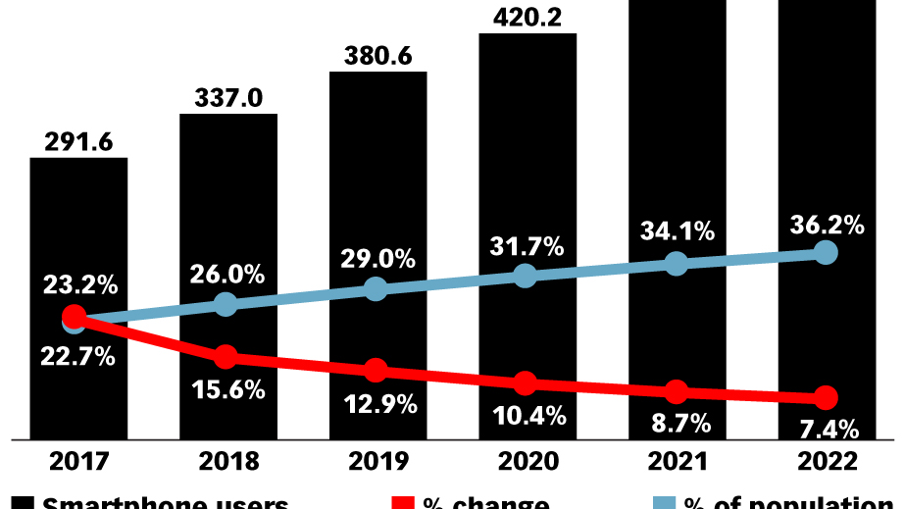
CONCLUSION
The Search Landscape:
A Reflection of India
India's search behavior reveals a nation passionate about sports, deeply rooted in cultural traditions, increasingly financially literate, and embracing digital transformation.
From 5M+ cricket match searches to 1M+ Dhanteras timing queries, each search tells a story of a dynamic, diverse, and digitally-engaged population navigating the world's largest democracy.
For businesses and marketers, understanding these patterns is key to connecting with India's 650M+ internet users effectively.
October 23-30, 2024
1,439 Topics Analyzed
36M+ Search Volume

